Slide 1
Prep:
Resources: https://github.com/isidore/Talks/blob/master/StrongStylePairProgramming.md
Feedback: https://forms.gle/agGpTvyHBvSvS2XZA
Menti 1 :
https://www.mentimeter.com/s/da8d1b21f013aefa7920193aa5489aab/fc2b0cb2c2a3
https://www.menti.com/hjvwub73o8
Menti 2:
Notes:
Given At:

Slide 2
Better Together
@LlewellynFalco

Slide 3

Resources

Slide 4
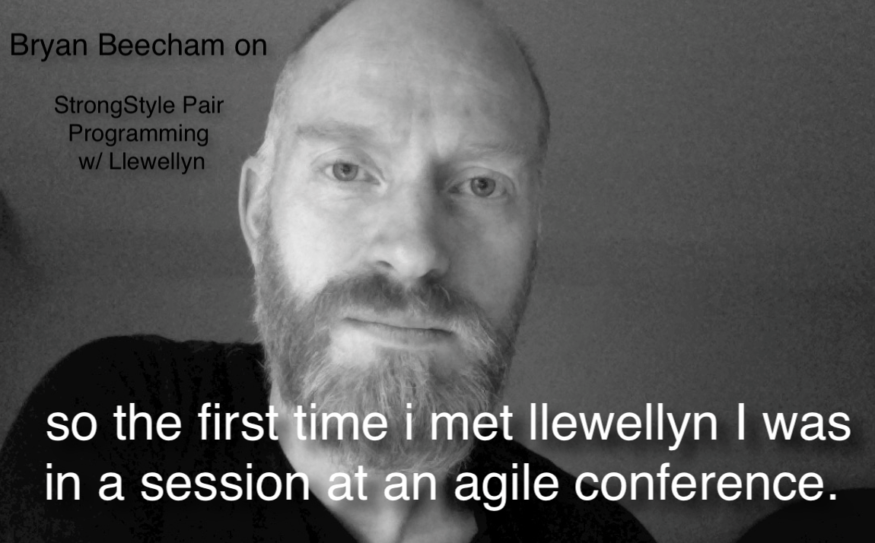


Slide 5
Programmer
Noun [proh-gram-er]
An organism that converts caffeine into code

Slide 6
Los Alamos New Mexico, USA

Slide 7
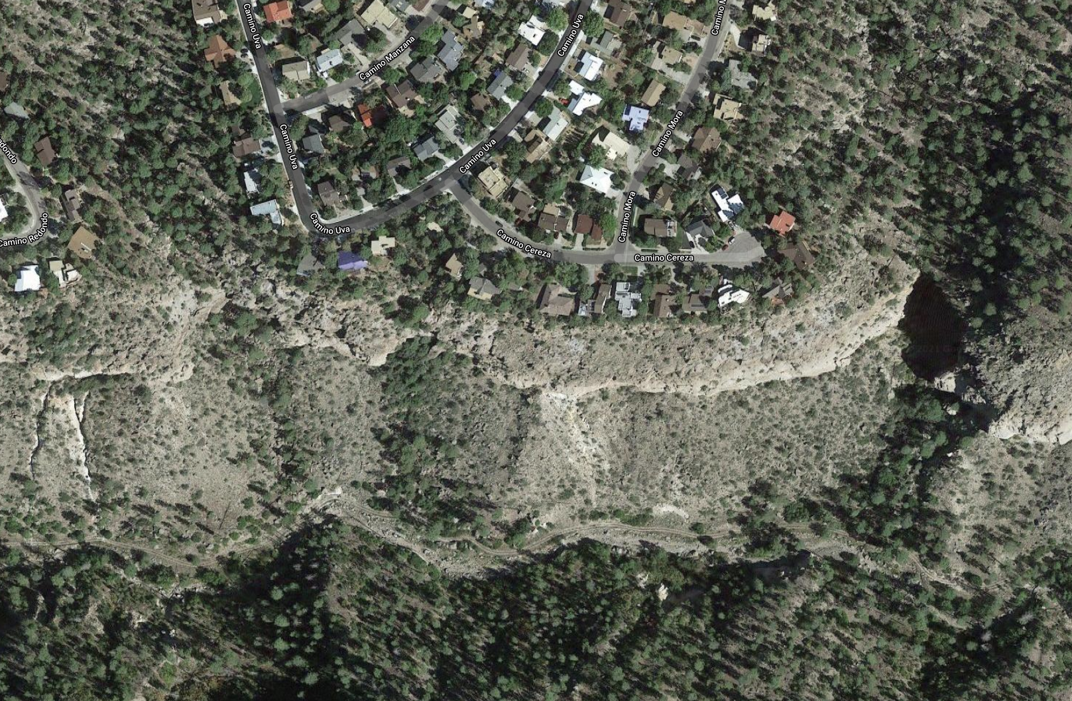

Los Alamos New Mexico, USA

Slide 8
Stories
3
from my neighbor…

Slide 9
Better Version of myself
Notes:
hetero economics theory

Slide 10
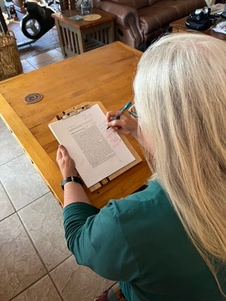
Indexing Hetero-economics theory
@LlewellynFalco

Slide 11
They are paying for your attention

Slide 12
Potential: Kate (solo)

Slide 13
Potential: Kate (solo)

Slide 14
Potential: Kate + 1 Hour of Llewellyn

Slide 15
Potential: Kate + 1 Hour of Llewellyn

Slide 16
Leveling up
New Practices
New Language
New Package
New Tooling
New Behavior
TDD
CI / CD
Definition of Done
Refactoring
Full Quality
Documentation
Code Reviews
UX
Testing
Procrastination

Slide 17
A Better You…
www.menti.com - use the code 6044 5708
What have you been wanting to improve?
Notes:
https://www.mentimeter.com/s/da8d1b21f013aefa7920193aa5489aab/fc2b0cb2c2a3

Slide 18
Learning
Bring the attention of your audience over a key concept using icons or illustrations

Slide 19
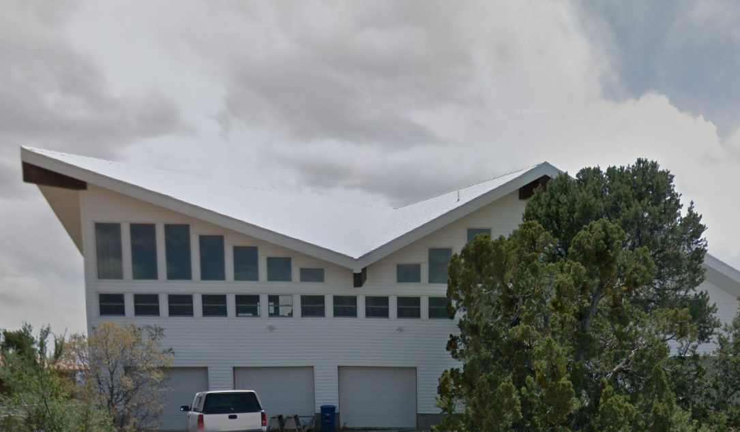
Bob (the builder)

Slide 20
I just need to sit down for a bit

Slide 21
he just makes it look so easy

Slide 22
Mentor/Mentee
On-Boarding
New Employee
New Team member
Up-Skilling
Skills
Technology
Take time to Reflect

Slide 23
Learning
www.menti.com - use the code 29 79 15 3
What have you been wanting to learn?

Slide 24
Creating
Bring the attention of your audience over a key concept using icons or illustrations

Slide 25
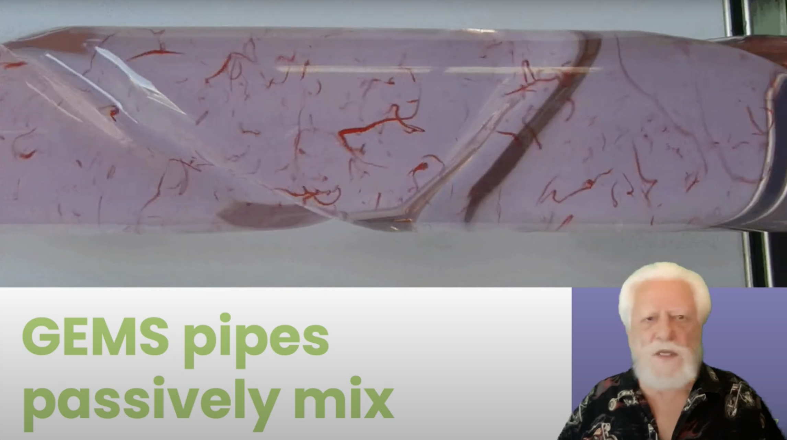
Algae Growth YouTube video

Slide 26
Just try it

Slide 27
Best of Both
Algae
Presentation Skills
CO₂ Consumption
Ethanol Plants
S
Green Screen
Fluid
Dynamics
Same Location
YouTube
GEM reactors
O
Fertilizer
Powerpoint
Science
Camtasia
Recording

Slide 28
Creating
Cross-Functional
Different sections of code
Different Specialty
Different Jobs
Wicked Problems
Important Problems

Slide 29
Creating
Mentimeter
What is the thing you been wanting to create really well?

Slide 30
Pairing Problems
Attention (1 person working, 1 person watching)
Intensity
Misunderstanding
Head Butting + Trust

Slide 31
Strong Style Pairing
“
For an idea to go from
your head to the keyboard
it must go through
someone else's hands
”

Slide 32
Traditional Pairing
“
I have an idea, let me take the keyboard
”
Strong Style Pairing
“
I have an idea, please take the keyboard
”

Slide 33
Problems
Attention (1 person working,
1 person watching)
If both people aren’t engaged nothing can happen
Misunderstanding
The other person must understand well enough to do it.
Learning
The less experienced person is mainly on the keyboard.
Head Butting
“Disagree and commit”
Intensity
Pomodoro’s and time limits

Slide 34
Intent
Location
Details
Save the file
In the upper right menu bar
Move the mouse up (1 inch) & left click on the disk icon

Slide 35
Trust
give me 5 minutes…

Slide 36





Slide 37
Resources
Notes:
https://github.com/isidore/Talks/blob/master/StrongStylePairProgramming.md

Slide 38
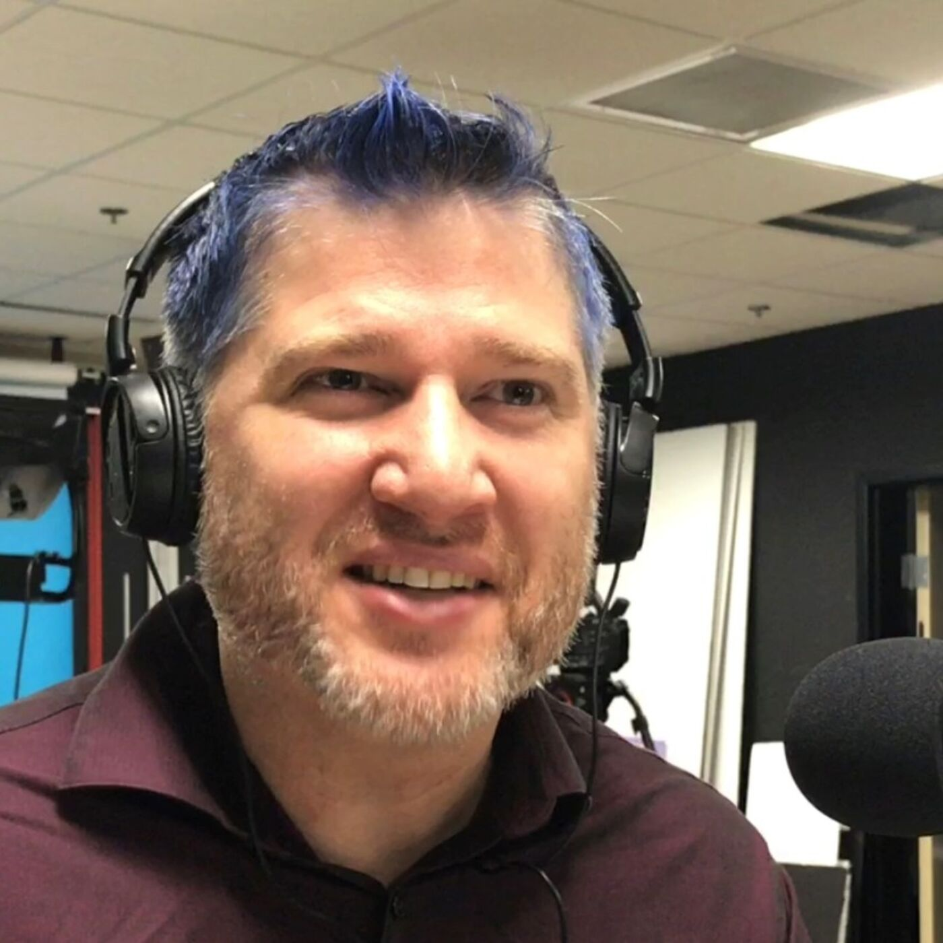

Thanks!
Please connect on Twitter & LinkedIn
@LlewellynFalco
LlewellynFalco.Blogspot.com
www.approvaltests.com
Slide template by:

